Slide 1
DEEP LEarNiNg MastEr Class
Day-28

Slide 2
01
CUDA Toolkit and cuDNN
Concept

Slide 3
NVIDIA CUDA Toolkit
A development environment for building GPU-accelerated applications.
This toolkit includes a compiler specifically designed for NVIDIA GPUs and associated math libraries + optimization routines.
cuDNN library
A development A GPU-accelerated library of primitives for deep neural networks. Using the cuDNN package, you can increase training speeds by upwards of 44%, with over 6x speedups in Torch and Caffe. for building GPU-accelerated applications.
This toolkit includes a compiler specifically designed for NVIDIA GPUs and associated math libraries + optimization routines.

Slide 4
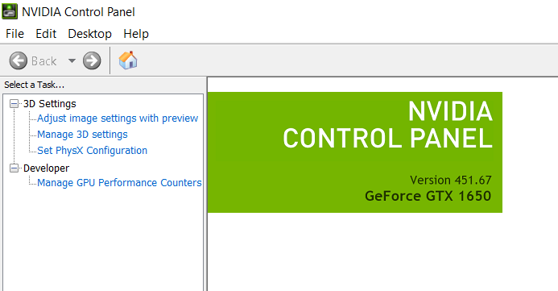
Checking the GPU Version

Slide 5
Step-1 Download cuda
Cuda toolkit – 10.0
https://developer.nvidia.com/cuda-toolkit-archive

Slide 6
Step-2 Download cudnn
CudNN - v7.6.5 for cuda 10.0
https://developer.nvidia.com/rdp/cudnn-archive

Slide 7
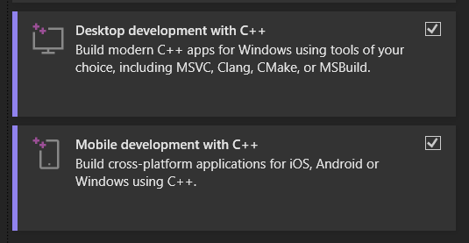
Step-3 Install visual studio
https://visualstudio.microsoft.com/vs/community/

Slide 8
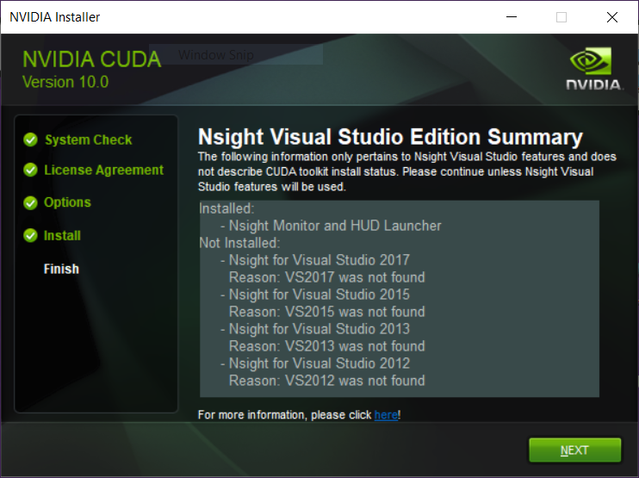
Step-4 Install cuda
Install it by clicking next, if u saw like in below

Slide 9
Step-5 Extract & Paste CUDNN
Extract cudnn zip file
Copy bin , include, lib folder
Open cuda installation directory (C:\Program Files\NVIDIA GPU Computing Toolkit\CUDA\v10.0)
Paste copied directories

Slide 10
Step-6 Config Environment Path
Configuring environment variables
C:\Program Files\NVIDIA GPU Computing Toolkit\CUDA\v10.0\bin
C:\Program Files\NVIDIA GPU Computing Toolkit\CUDA\v10.0\libnvvp

Slide 11
Step-8 Installing Tensorflow
Tensorflow gpu 2.0.0
Pip install tensorflow-gpu==2.0.0

Slide 12
Step-9 Ensure
Communication is happening between
library and our gtx

Slide 13
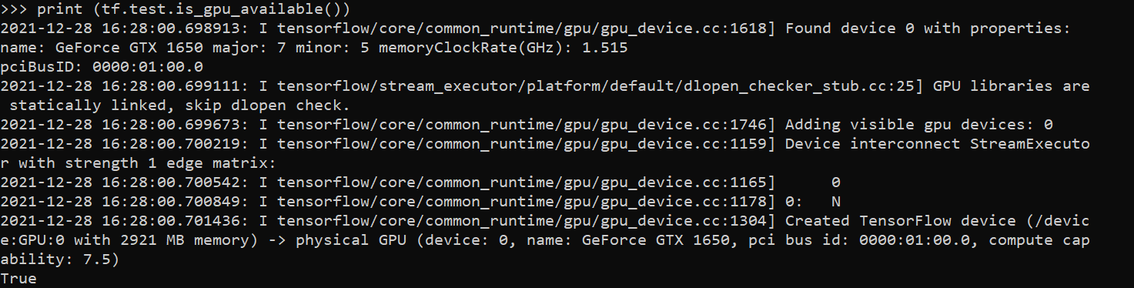
Step-10 Checking TF GPU
Import tensorflow as tf
print (tf.test.is_gpu_available())

Slide 14

Step-11 Checking CUDA
Import tensorflow as tf
print(tf.test.is_built_with_cuda())

Slide 15
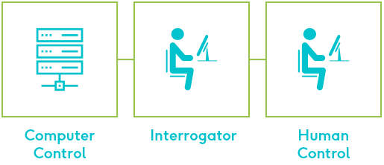
Deep Learning Terminology - 1
Turing Test
A test developed by Alan Turing 1950, which is meant as a means to identify true artificial intelligence.
The test is based on a process in which a series of judges attempt to discern interactions with a control (human) from interactions with the machine (computer) being tested.

Slide 16
Deep Learning Terminology - 2
Pruning
Overriding unnecessary and irrelevant considerations in AI systems.

Slide 17
Deep Learning Terminology - 3
Agent
Also called assistants, brokers, bots, intelligent agents is an autonomous entity which observes through sensors and acts upon an environment using actuators.

Slide 18
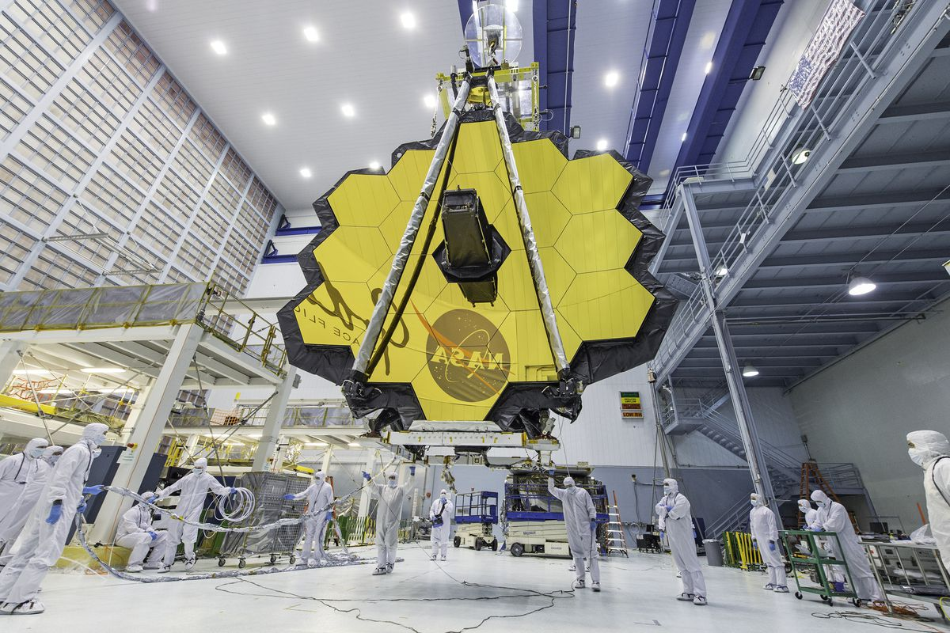
Tech News
Short bytes – D28
All the news from NASA’s James Webb Space Telescope mission
After decades of work, the launch is here
It’s taken roughly 25 years for NASA to get this vehicle ready for launch, and sending it to space is an incredibly complex endeavor. But if everything works out just right, JWST promises to see deeper into the Universe than ever before, peering at some of the most ancient stars and galaxies while deepening our understanding of astrophysics.

Slide 19
Q & A Session

Slide 20
Thanks!
Thanks!
Follow Me on LinkedIn : Link in Description
+91 7305845758
Pantechsolutions.net

